Slide 1



Cryosphere-associated minerals in saline lakes on Earth as analogs of ancient Martian lakebeds
Gage Driscoll
In association with NASA and the University of Arizona

Slide 2
Intended Purpose of Research
How can we make conclusions about the geographical composition of Mars without being able to quantitively extract data from the planet’s surface?
What can images of Earth tell us about Mars?

Slide 3
Earth as analogs of ancient Martian lakebeds
The Advanced Spaceborne Thermal Emission and Reflection Radiometer (ASTER) is an instrument aboard NASA’s “Terra” satellite
Every time this satellite makes an orbital pass above Earth, it collects reflectance data of Earth’s surface
We can use this reflectance data, coupled with what we can determine about the physical composition of Earth’s surface, to make a catalog of information that can be used as an analog for inferring the composition of Martian Lakebeds

Slide 4
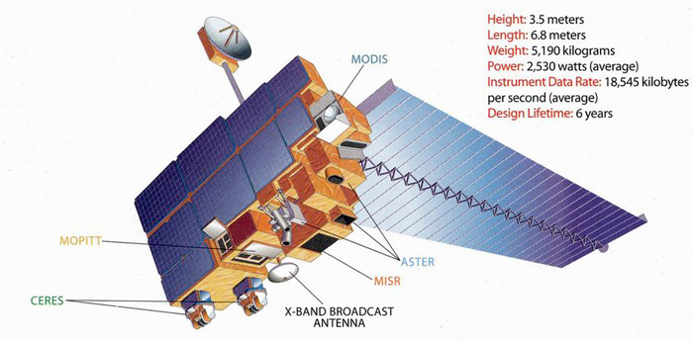
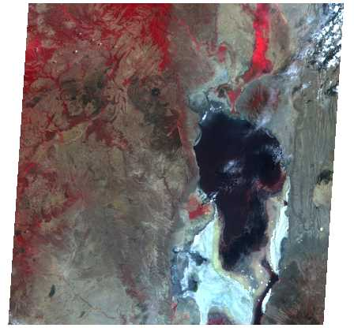
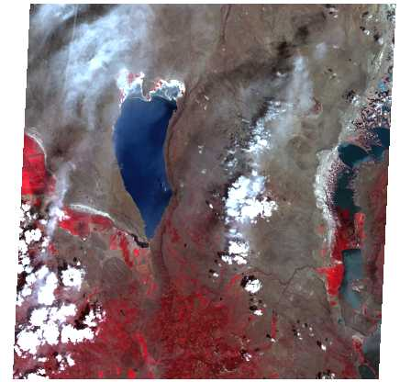
Lake Natron, Africa
Lake Abert, Oregon

Slide 5
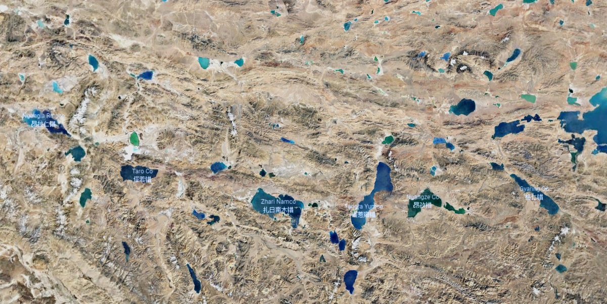
Western Tibet

Slide 6
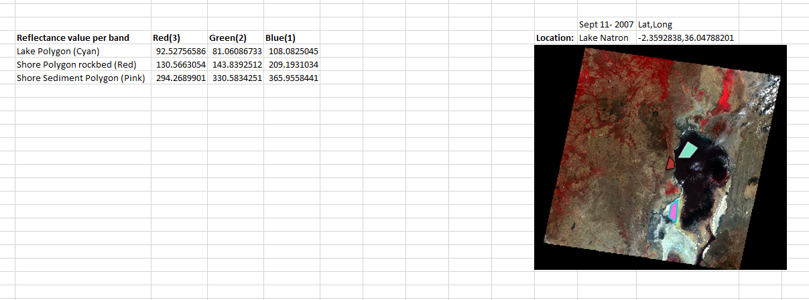
Procedure and Methods of Research

Slide 7
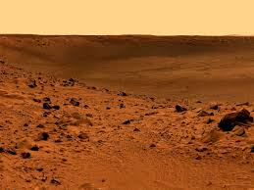
Implications
Was Mars once capable of supporting life?
Is Mars capable of supporting life or industry in the future?
How similar is the surface of Mars to that of Earth?
Smithsonianmag.com

Slide 8

Acknowledgments
Jeffrey Kargel from Hydrology & Atmospheric Science Department
The University of Arizona NASA Space Grant Consortium
Family and Friends who made it out today and have supported me through this incredibly rewarding process

Slide 9

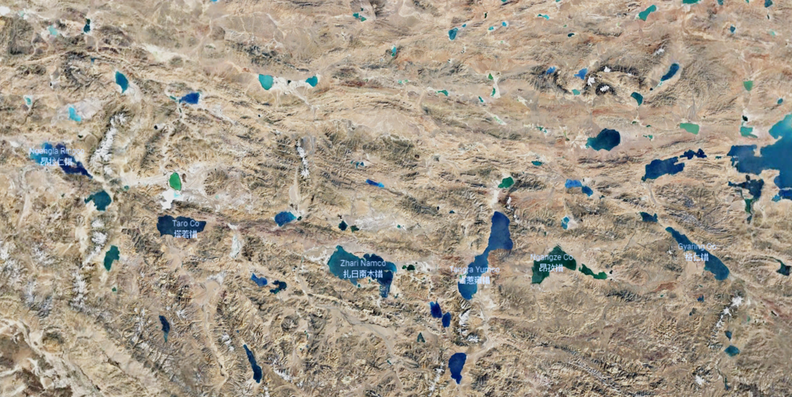
Questions

